Slide 1



ScholarBridge
Where Every Scholarship Finds You
Team No. : C49
Team members:
Soumil Mukhopadhyay - 16010122257
Mayur Dumbre - 16010122051
Hriday Gandhi – 16010122055
Farzan Irani - 16010122065
Guide: Prof. Shivani Deosthale

Slide 2

ScholarBridge
Describe your Idea / Solution / Prototype:
We have created a web-based Scholarship Management Platform that unifies multiple trusts and students in one ecosystem, providing a single point of application for students and transparent fund allocation for trusts.
The prototype will function as follows:
One Application, Many Trusts – Students fill one annual form that reaches multiple verified trusts, maximizing outreach and scholarship opportunities.
Verified Ecosystem – Both students and trusts undergo verification, ensuring authenticity and reducing fraud.
Secure Data Handling – All sensitive details (Aadhaar, PAN, bank info, documents) are encrypted at the application layer before storage.
Fair & Transparent Approvals – Database-level checks prevent over-approvals; audit logs ensure accountability.
Payment Reconciliation Loop – Trusts mark payments, students confirm receipt, and unresolved cases are auto-flagged to SuperAdmin.
Trust Analytics Dashboard – Trusts can view yearly donations, education-field breakdowns, and trends with charts and reports.
Blacklist & Issue Resolution – Suspicious students/trusts can be blacklisted; unresolved issues tracked via admin dashboards.
Aspect | Current Portals | ScholarBridge
Application | Multiple forms per trust | One form → many trusts
Financial Control | App-level checks, error-prone | DB triggers prevent over-approval
Reconciliation | Manual, dispute-prone | Automated loop: pay → confirm → flag
Data Security | Basic storage, weak encryption | App-layer AES-256, signed URLs
Analytics | Minimal lists/reports | Dashboards: trends, yearly spend
Auditability | Logs are incomplete/tamperable | Immutable audit logs

Slide 3
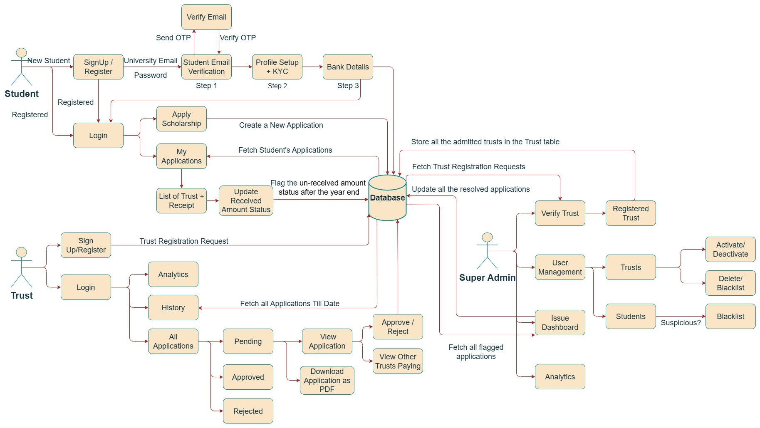
TECHNICAL APPROACH
Tech Stack used:
Frontend (React.js + Tailwind)
Backend (Node.js + Express.js)
Database (PostgreSQL)
Analytics Charts (Chart.js)

Slide 4
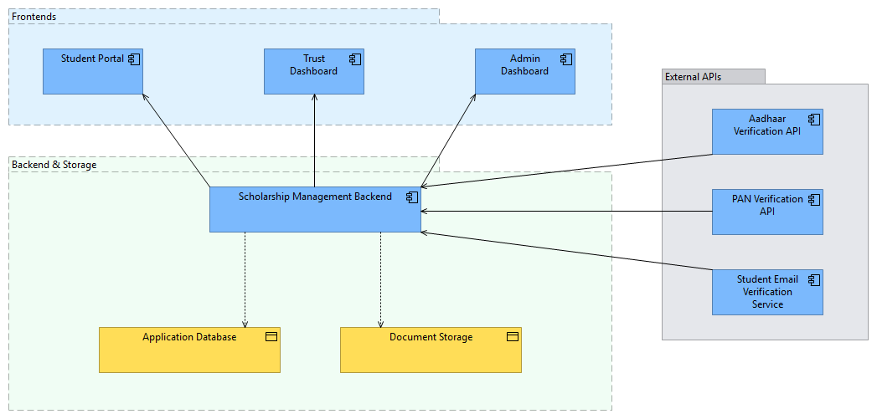
ARCHITECTURE DIAGRAM
Application View

Slide 5
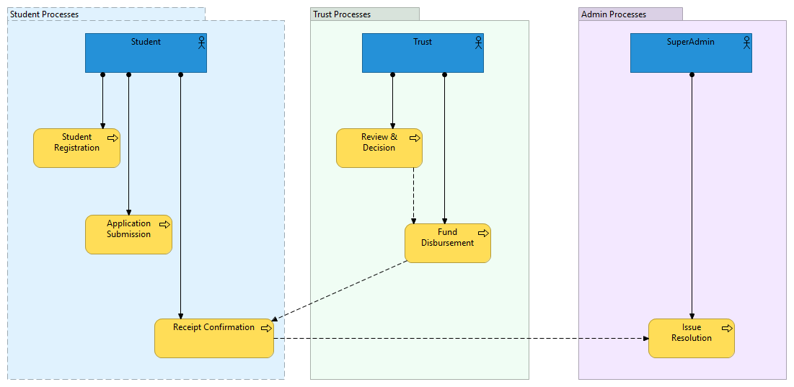
ARCHITECTURE DIAGRAM
Business View

Slide 6
FEASIBILITY AND VIABILITY
Feasibility & Viability:
Technical Feasibility
  Built on scalable PERN stack (PostgreSQL, Express, React, Node).
  DB-level triggers ensure robust financial controls
  App-layer AES-256-GCM encryption secures sensitive PII.
Operational Feasibility
  One-application model reduces student workload, increasing adoption.
  Trust dashboards and reports ease fund management.
  SuperAdmin layer ensures governance & dispute resolution.
Financial Feasibility
  MVP deployable on free/low-cost tiers (Render, Neon, Cloudinary).
  Minimal infra cost in pilot phase (₹0–₹2k/month).
  Long-term: monetization via trust subscriptions & analytics services.
Challenges | Strategies to Overcome
Reliable KYC verification (APIs costly, limited availability) | Use manual verification + optional paid API fallback for pilot phase
Preventing over-approval under simultaneous trust actions | Enforce DB triggers & transaction isolation (SELECT FOR UPDATE) to guarantee atomic checks
Ensuring encryption & data security without performance loss | Apply AES-256-GCM at app layer; display only masked values in UI
Building accurate & useful trust analytics | Start with basic charts (funds by year/field), scale gradually to advanced dashboards
Gaining adoption & trust from students and NGOs | Transparent audit logs, one-application model, and Super Admin governance build confidence

Slide 7
IMPACT AND BENEFITS
Potential Impact on Target Audience:
Students: Greater scholarship reach with a single form, reduced effort, higher chances of aid, and assurance of fair distribution.
Trusts / NGOs: Transparent fund allocation, easier application review, prevention of duplicate/false beneficiaries, and better analytics for planning.
Super Admin / Regulators: Stronger governance through audit logs, dispute resolution, and blacklisting to maintain credibility of the ecosystem.
Society at Large: More students receiving timely aid → higher educational opportunities → stronger, skilled workforce.
Benefits of the Solution:
Social: Promotes equal access to scholarships, reduces bias/fraud, empowers underprivileged students.
Economic: Efficient use of trust funds, reduced admin overhead, sustainability via subscription/analytics model.
Governance: Transparent, accountable ecosystem with immutable logs and automated reconciliation.
Business Model Opportunities
Government / Institutional Partnerships: Collaborate with education boards and state agencies to expand scholarship outreach.
Trust Subscriptions: Offer premium analytics dashboards and bulk application handling for a fee.
Corporate CSR Integration: Allow corporates to onboard their CSR scholarship programs on the same platform.
Value-added Services: Verified KYC, automated document verification, and advanced analytics as optional paid features.

Slide 8
RESEARCH AND REFERENCES
[1] National Scholarship Portal, “About NSP,” Ministry of Electronics & Information Technology, Government of India. [Online]. Available: https://scholarships.gov.in/. [Accessed: 02-Sep-2025].
[2] A. Al-Fedaghi, “Conceptualization of Audit Logs,” International Journal of Network Security & Its Applications (IJNSA), vol. 3, no. 6, pp. 127–141, Nov. 2011.
[3] E. Blancaflor, P. A. I. Caseńas, L. J. H. Rocamora, J. I. Y. Rosete and W. Rey, "APPly: A Design of an Online Tertiary Level Scholarship Application Management System," 2022 International Communication Engineering and Cloud Computing Conference (CECCC), Nanjing, China, 2022, pp. 74-78, doi: 10.1109/CECCC56460.2022.10069218. keywords: {Cloud computing;Scholarships;Delay effects;Web servers;Task analysis;Website Application;Web Servers;Scholarship Management}
[4] Orgianus, Yan, et al. "Optimizing scholarship distribution: a management information system approach." Acta Logistica 11.2 (2024): 197-209.
[5] Jibrin, Mohammed Abdullahi, Muhammad Ndagie Musa, and Shittu Tahir. "Development of E-Scholarship System." International Journal of Computer and Information Technology 7.2 (2016): 523-530.
[6] World Bank Group, “Technology for Transparency and Accountability: A Global Impact,” World Bank Report, 2021. [Online]. Available: https://www.worldbank.org/. [Accessed: 02-Sep-2025].
[7] A. Sharma and P. Gupta, “Application of Data Analytics in NGOs for Effective Fund Management,” International Journal of Computer Applications, vol. 183, no. 32, pp. 15–20, 2021.
[8] Cloudinary Docs, “Image and Video Management as a Service,” Cloudinary, 2024. [Online]. Available: https://cloudinary.com/documentation. [Accessed: 02-Sep-2025].

